Slide 1
Heredity
Nucleic Acids (DNA & RNA) Structure and Function
Created by CENGAGE Learning
Edited by Ms Rayner, 2022

Slide 2
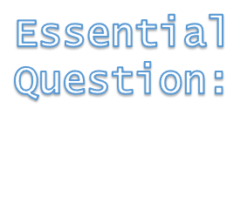
The structural properties of the DNA, including nucleotide composition and pairing and the hydrogen bonds between strands of DNA allow for replication
State the scientists and the discoveries they made that have led to our current understanding of the structural properties of DNA
Syllabus:

Slide 3
What you need to complete
Read Chapter 3 Biology WA ATAR Units 3 & 4
Answer Biology WA ATAR Question Sets
    Set 3.2 pg.59 Q 1-5
    Set 3.3 pg. 63 Q1 – 5
    Set 3.4 pg. 65 Q 1 – 4
    Set 3.5a pg. 66 Q 1 – 4
    Set 3.5b pg. 69 Q 1 – 4
    Set 3.5c pg. 73 Q 1 – 4
    Set 3.6 pg. 75 Q 1 – 5
    NOTE: Some of these question have been used in this PPT and the note taking scaffold. These are to be completed over 2 weeks
Biozone Activities
    120
    121
    122
    123
    124
    126
    127
    128
    129
    130
    195

Slide 4

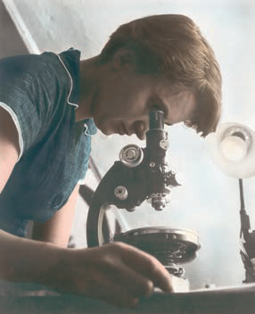
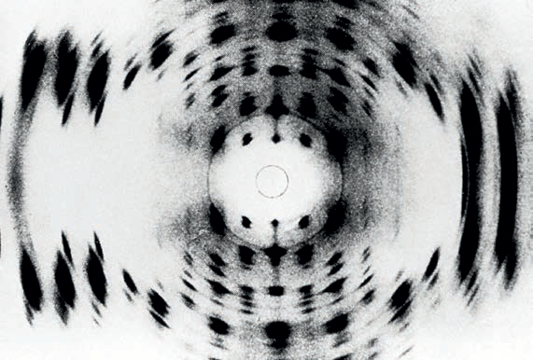
The discovery of DNA
Alamy Stock Photo/Science History Images
WATCH: https://www.youtube.com/watch?v=BIP0lYrdirI
Alamy Stock Photo/Science History Images

Slide 5
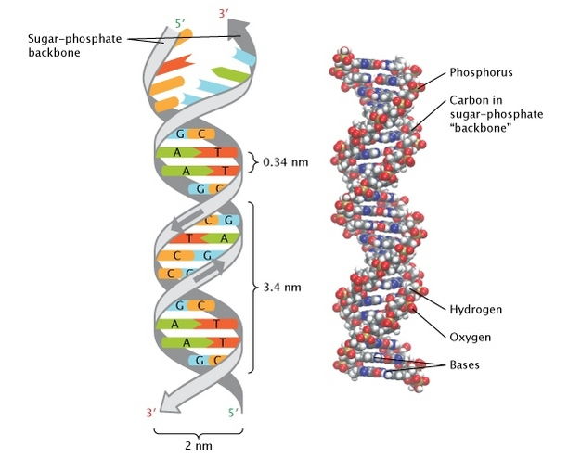
Topic Question 2: Describe Watson and Crick’s model of DNA
The discovery of DNA

Slide 6
Topic Question 3: Name the scientist who discovered complementary pairing and describe this discovery
The discovery of DNA
Erwin Chargaff determined the ratios of the four types of nitrogenous bases in the nucleotide subunits: adenine (A), cytosine (C), guanine (G) and thymine (T).
He concluded that the amount of guanine was equal to the amount of cytosine, and the amount of adenine was equal to the amount of thymine.
Complementary pairing means:
Guanine always hydrogen bonds with cytosine
Adenine always hydrogen bonds with thymine.
Guanine and cytosine share three hydrogen bonds
Adenine and thymine share two hydrogen bonds.

Slide 7
Topic Question 4: Complete the table of complementary base pairs in DNA
Nitrogenous Base | Complementary Base Pair
A_________
C_________
T_________
G_________

Slide 8
DNA is a helical double-stranded molecule that occurs bound to proteins in Chromosomes in the nucleus, and as unbound circular DNA in the cytosol of prokaryotes, and in the mitochondria and chloroplasts of eukaryotic cells
Compare DNA of prokaryotic and eukaryotic cells
Syllabus:

Slide 9
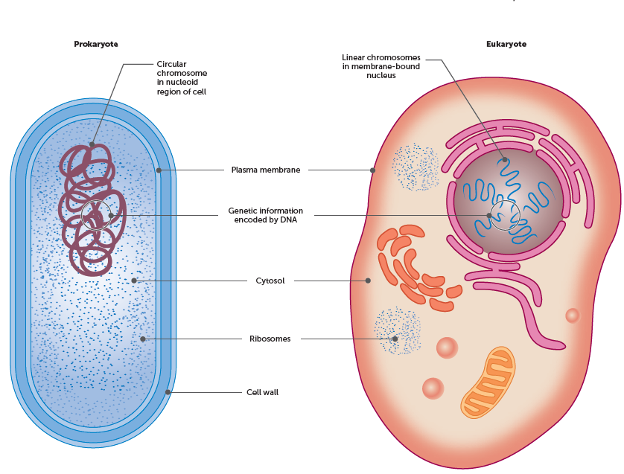
The discovery of DNA
REVISION – Where is DNA found in Eukaryotic & Prokaryotic Cells?
There are structural differences between prokaryotic cells and eukaryotic cells.

Slide 10
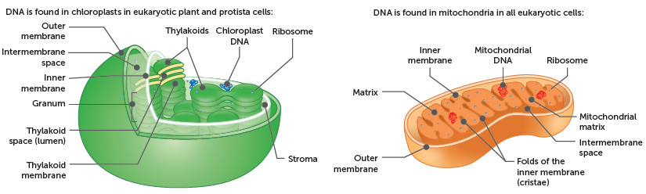
The discovery of DNA
REVISION – Where is DNA found in Eukaryotic & Prokaryotic Cells?
Eukaryotic cells:
In the nucleus
  Linear DNA
  bound to proteins & is tightly coiled to form chromosomes in
  enclosed in a nuclear membrane.
Mitochondria and chloroplasts
  Circular DNA
  Not bound to proteins

Slide 11
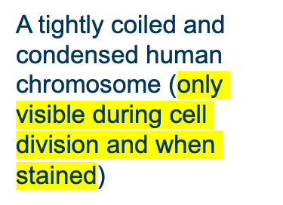
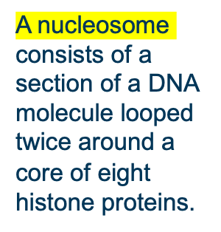
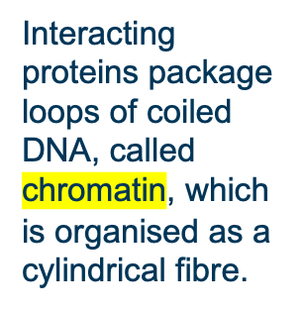
Chromosomes of eukaryotes
REVISION – Where is DNA found in Eukaryotic & Prokaryotic Cells?
Chromatin is further condensed to make chromosomes.

Slide 12
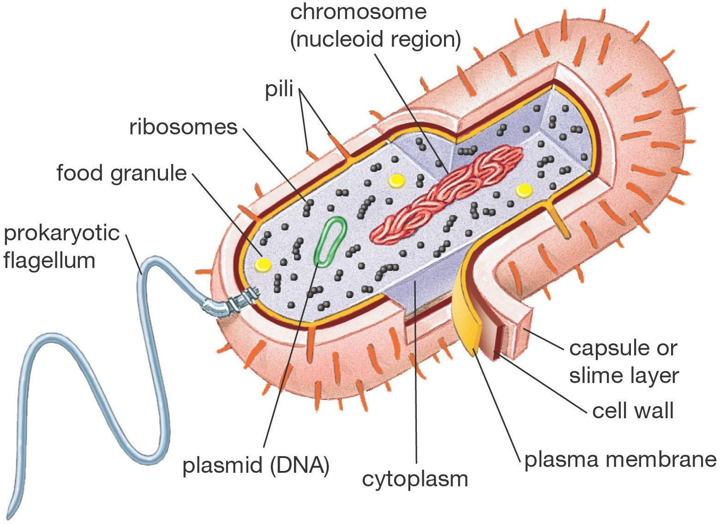
The discovery of DNA
RECAP – Where is DNA found in Eukaryotic & Prokaryotic Cells
Prokaryotic cells:
DNA occurs as unbound circular DNA
in the nucleoid region of the cytosol.
The nucleoid region is not bound by
a nuclear membrane.

Slide 13
The structural properties of the DNA molecule, including nucleotide composition and pairing and the hydrogen bonds between strands, allow for DNA replication
Select, construct and use appropriate representations, including models of DNA replication to communicate conceptual understanding, solve problems and make predictions
Describe the structure of DNA and explain how this is linked to its function
Use a labelled diagram of a DNA molecule to describe its function
Syllabus:

Slide 14
WATCH!
https://www.youtube.com/watch?v=8m6hHRlKwxY&list=PLsMs3sjjy-pCcR8l3ohnIUhIiCwEjQB6K&index=3

Slide 15
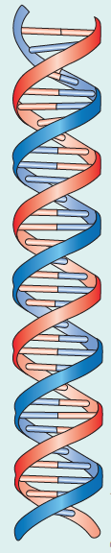
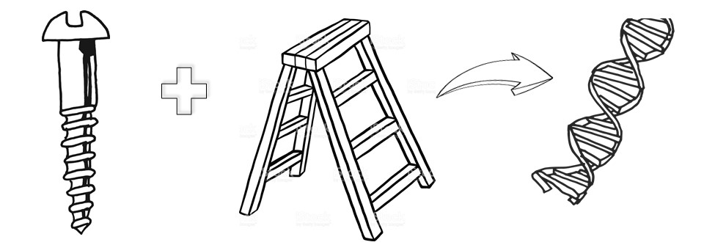
DNA structure − DNA molecule
Topic Question 1: Describe the shape of DNA
The Shape
The shape of a DNA molecule is a double helix.
The term ‘double’ means the molecule consists of two strands.

Slide 16
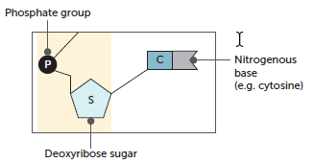
DNA structure − nucleotides
Topic Question 2: Describe the structure of DNA nucleotides, the building blocks of the DNA molecule
DNA is a nucleic acid made up of nucleotides.
They are basic strutural unit of DNA
Each nucleotide consists of three parts:
  a five-carbon (pentose) sugar known as deoxyribose sugar,
  a phosphate group
  a nitrogenous base (adenine, cytosine, guanine or thymine).

Slide 17
Topic Question 3: Draw a diagram of a nucleotide

Slide 18
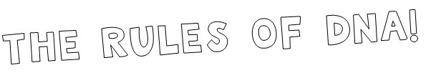
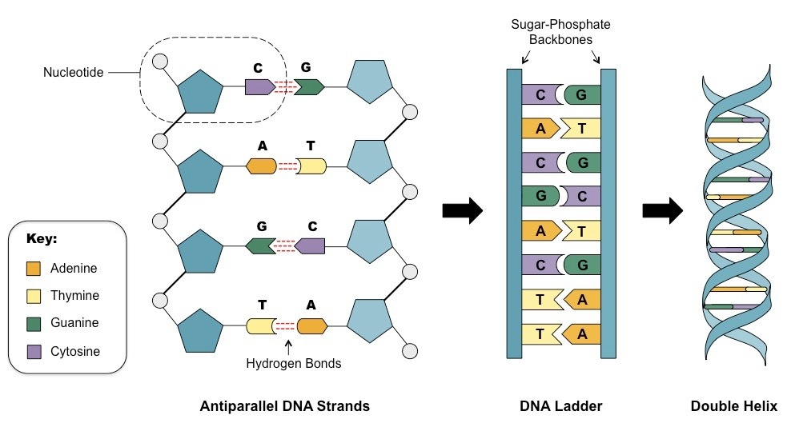
Topic Question 4: Draw a diagram to show the complementary base pairing rule.

Slide 19
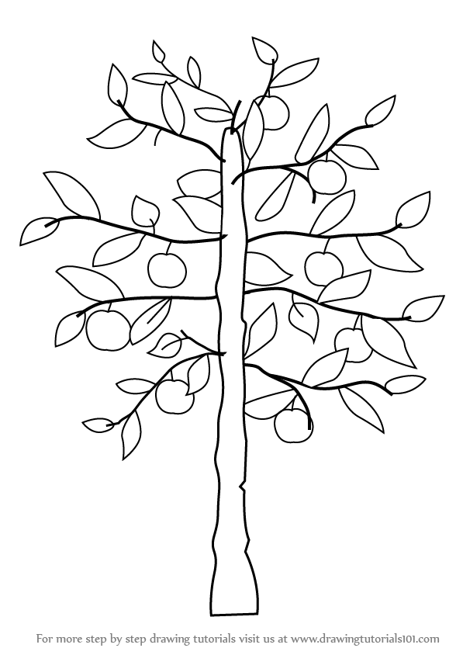
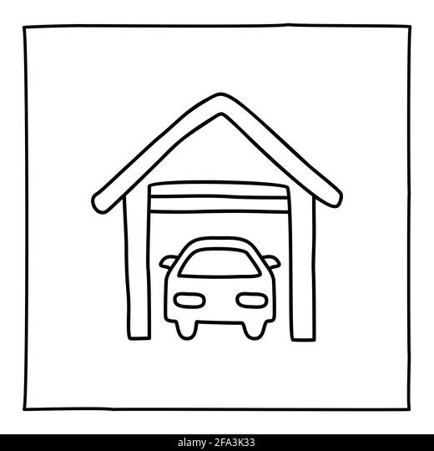
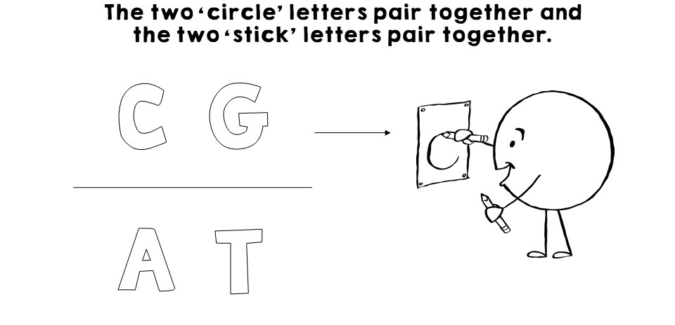
Topic Question 5: What are some ways to remember how the bases pair together

Slide 20
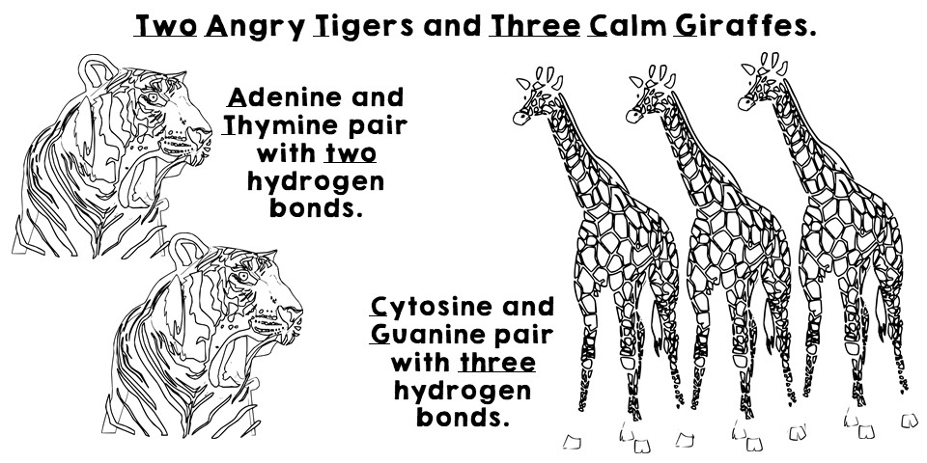
Topic Question 5: What are some ways to remember how the bases pair together

Slide 21
Topic Question 6: Describe the bonds between the nucleotides of the DNA strands
The Rungs
Nucleotides are the building blocks of the DNA molecule
The strands are joined by weak hydrogen bonds between complementary pairs of nitrogenous bases of the nucleotides
The complementary base pairing means that adenine always pairs with thymine and cytosine always pairs with guanine

Slide 22
Topic Question 7: What type of bond forms between sugar and phosphate molecules of DNA nucleotides

Slide 23
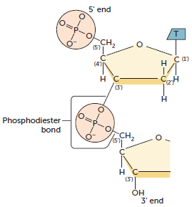
DNA structure − nucleotides
Topic Question 7: What type of bond forms between sugar and phosphate molecules of DNA nucleotides
Each phosphate group is attached to two sugar molecules by ‘ester’ bonds and is called a phosphodiester bond.
The five molecule carbon atoms in each sugar molecule form a ring and are numbered 1’ to 5’.
A phosphodiester bond is formed with the 3’ carbon of one sugar ring and the other is formed with the 5’ carbon of the next sugar ring.
This allows for adjacent nucleotides to be joined together
The bond between nucleotides

Slide 24
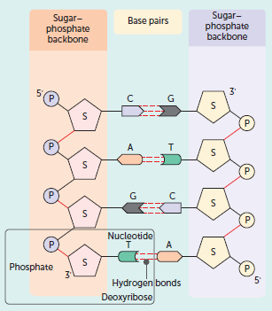
DNA structure − DNA molecule
Topic Question 8: Describe the structure of the DNA backbone
The Backbone
The DNA structure includes a chain of alternating sugar molecules and phosphate groups: the sugar–phosphate backbone.

Slide 25
DNA structure − DNA molecule
Topic Question 8: Describe the structure of the DNA backbone
The Backbone
There is a 5’ and 3’ end of the Sugar-phosphate backbone.
The 5’ end terminates with a phosphate molecule
The 3’ with a sugar molecule
The DNA strands are anti-parallel, meaning the two stands run in opposite directions to each other

Slide 26
Topic Question 9: Using a labelled diagram describe the structure of DNA

Slide 27
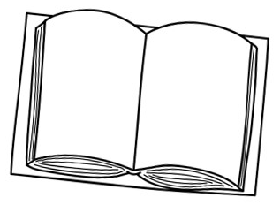
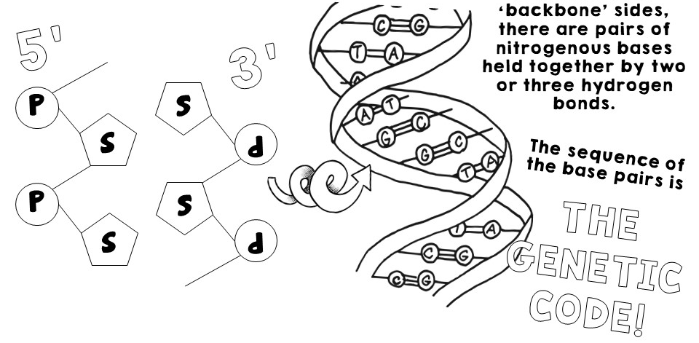
DNA structure
Topic Question 10: Explain how the structure of DNA is linked to its functions
Stores genetic information required for the development of cells and the information is passed from one generation to the next

Slide 28
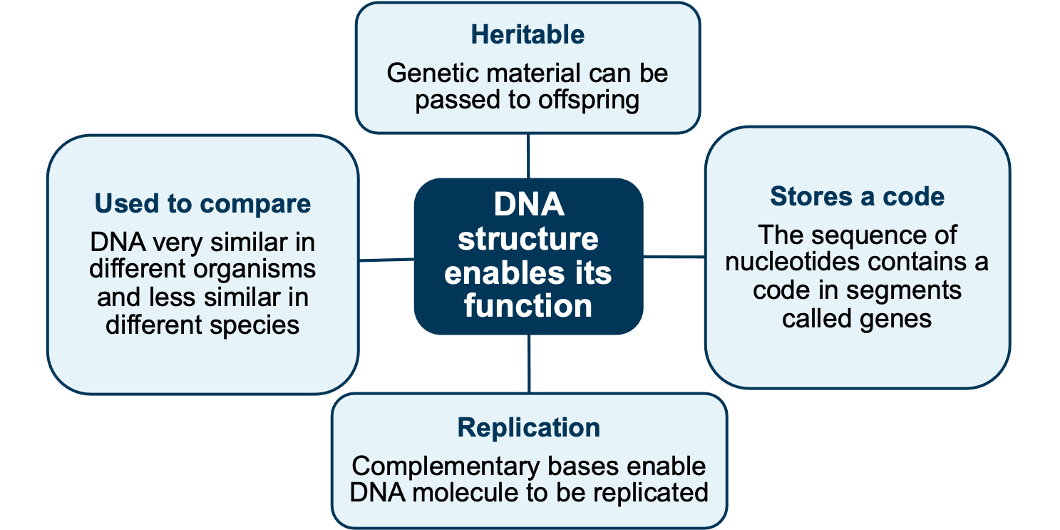
DNA structure
Topic Question 10: Explain how the structure of DNA is linked to its functions
Because it can be replicated it can be passed from parent cell to daughter cell
All living things contain DNA
Weak hydrogen bonds mean they can be easily broken the 2 strands of DNA separated
These genes code for proteins or RNA

Slide 29
Syllabus:
Protein synthesis involves transcription of a gene into messenger RNA in the nucleus, and translation into an amino acid sequence at the ribosome
Describe the structure of RNA and explain how this relates to its function.
Compare DNA and RNA

Slide 30
Topic Question 1: Describe what RNA is
RNA – ribonucleic acid
    Information molecule
    Involved in protein synthesis, reads chemical code (gene) on DNA and constructs polypeptide chain of amino acids at ribosome.

Slide 31
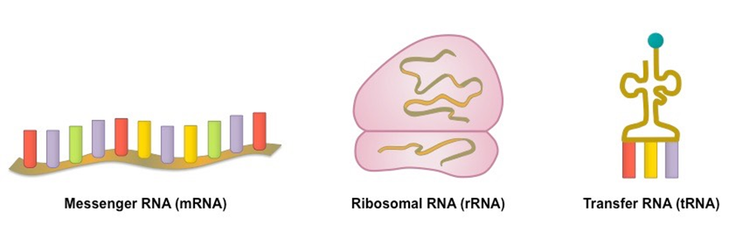
Topic Question 2: Describe the structure of RNA
  Three main types of RNA
      Messenger – mRNA
      Transfer – tRNA
      Ribosomal – rRNA
All single stranded
Shape depends on function (we will learn the function of each type of RNA when we go through protein synthesis

Slide 32
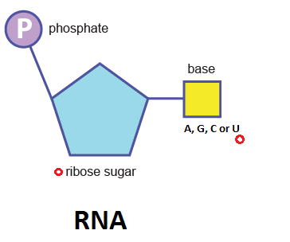
Topic Question 3: State the components of RNA nucleotides

Slide 33
Topic Question 4: Draw a labelled diagram of an RNA nitrogenous base

Slide 34
Topic Question 5: State how nitrogenous bases of RNA pair
Come up with a way to remember how nitrogenous bases pair in RNA
RNA
  Adenine pairs with Uracil
  Cytosine pairs with Guanine
  NOTE: RNA is single stranded. You need to know how RNA nitrogenous bases pair for protein synthesis

Slide 35
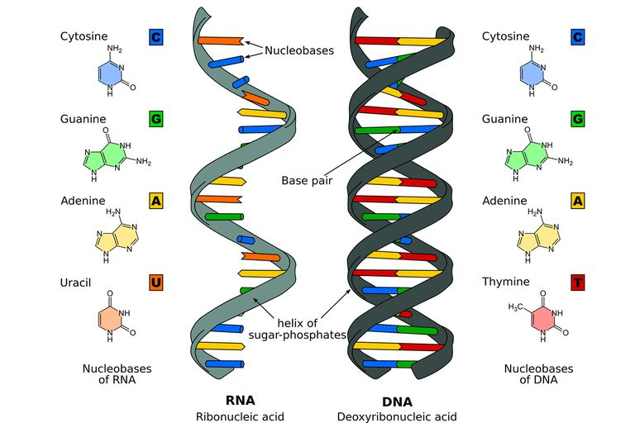
Topic Question 6: Draw a diagram to show the structure of a single strand of RNA

Slide 36
Topic Question 7: Compare the structure of DNA and RNA
WATCH: https://www.youtube.com/watch?v=JQByjprj_mA
DNA | RNA

Slide 37
Make a model of DNA & DNA replication
Cut out diagram A along solid lines
Cut out diagram B and C along solid lines and fold along dotted lines. On the shaded tab ONLY, cut the solid, horizontal line marked ‘cut’
Collect 2 x paper fasteners
Connect Diagrams B and C to Diagram A using the paper fasteners
Colour your diagram of DNA and make a Key for the different molecules

Slide 38
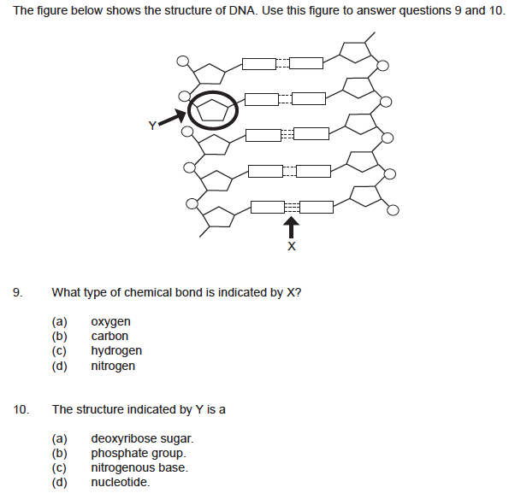
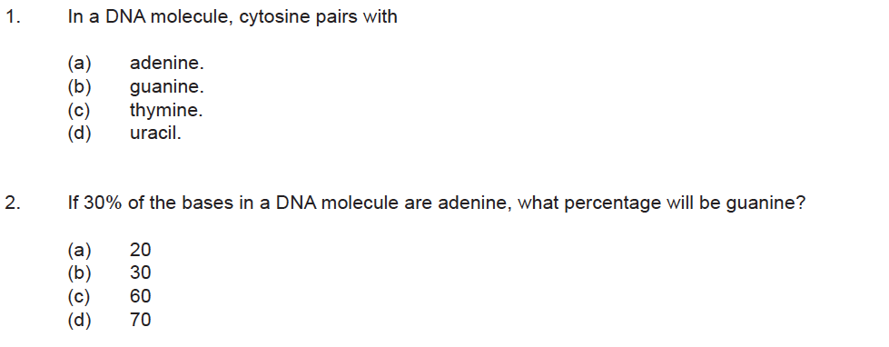
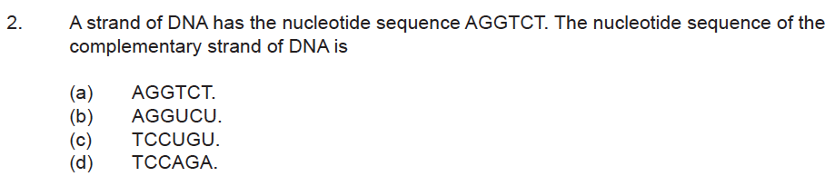
SUM IT UP!
Describe the functions of DNA and messenger RNA
List 4 ways the structure of RNA differs from DNA
Using the Complementary base pairing rule to complete the table below of the numbers of nitrogenous bases of a DNA molecule
Adenine | Cytosine | Thymine | Guanine
7 | 3 | 7
21 | 25 |  | 25
 |  | 43 | 44

